Slide 1
Citizen Empowerment for a
Circular Textiles Sector in Amsterdam
EveryCycle
Notes:
Hello everyone, I’m Lynn, a retired software developer and business analyst, now working on open source software for new networked sustainable economies, and I’ll be presenting the EveryCycle proof of concept, citizen….

Slide 2
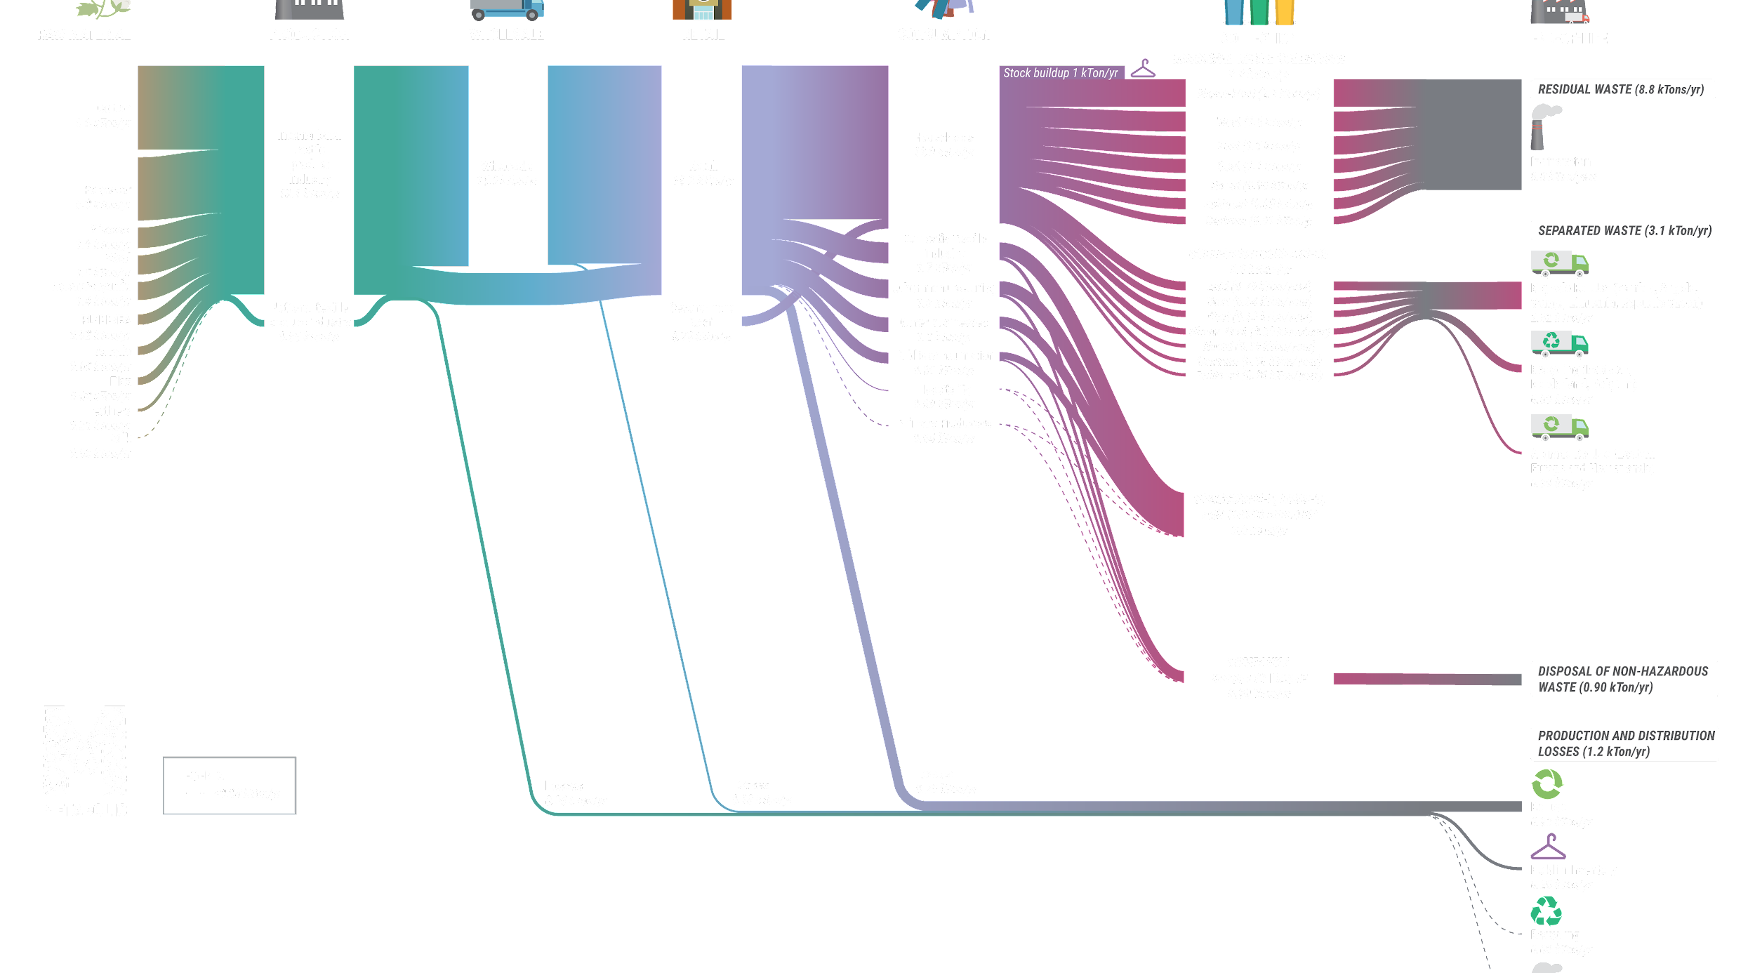
The Challenge
Textiles is a critical and polluting industry since the Industrial Revolution – each year, 14,000 tonnes of textiles are thrown away in Amsterdam alone.
The linear make-take-waste model is the industry’s default. The vast majority of textiles discarded within the city end up incinerated together with regular waste.
Notes:
First the challenge. Every year in Amsterdam, 14,000 tonnes of textiles are thrown away, and mostly end up incinerated with regular waste. This is a resource flow model showing the linear nature of this currently.

Slide 3
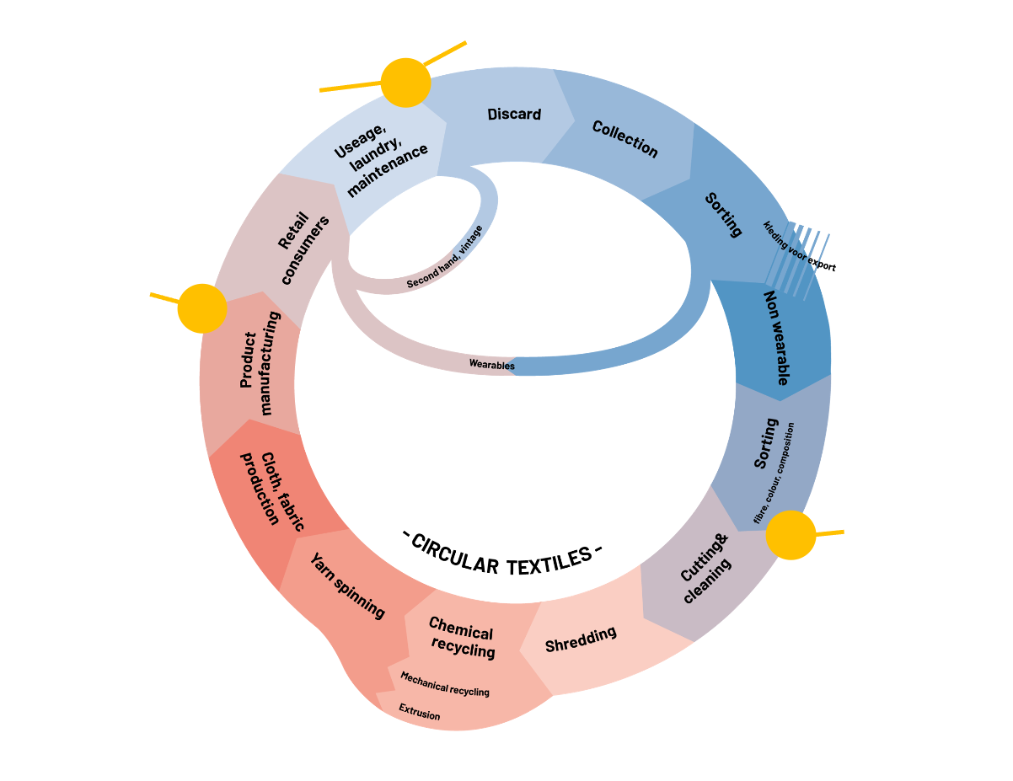
Amsterdam’s Ambition
The City of Amsterdam is rethinking the lifecycle of textiles in collaboration with citizens and other stakeholders.
The Amsterdam REFLOW challenge is to transform its textile sector from linear to circular by increasing the volume of collected textiles and bringing them back into local loops and supply newly produced products within the city out of recycled resources (and thus create business opportunities).​
​
Starting from the material dimension, we tackle the challenges by developing digital technologies that can engage citizens in better disposal and collection practices. ​
​
Notes:
So, Amsterdam is rethinking this textile lifecycle, and looking at multiple ways to transform it from linear to circular, and at the same time create local business opportunities. The EU funded Reflow project was created to encourage circular economies in 6 pilot municipalities across Europe, including Amsterdam.

Slide 4
Engaging Citizens
CITIZEN ENGAGEMENT
INSIGHTS
The city wants to create an awareness campaign focused on:
Increasing the collection of home textiles waste at city level by informing and engaging citizens
Extending the life cycle of textiles through redistribution, reuse and repair
Municipality research has identified:
Citizens don’t know how to address their textile waste correctly. There is a lack of clarity how the system works and what are the processing steps behind it.
Overall citizens distrust the City’s collecting, sorting and recycling system.
Notes:
The Reflow project is a 3 year project, still in progress. Research has identified….. So the city wants to create an awareness campaign to increase collection of home textile waste and extend the life cycle of textiles. The EveryCycle project is an opportunity to start to quickly address citizen engagement as a part of the overall Reflow solution.

Slide 5
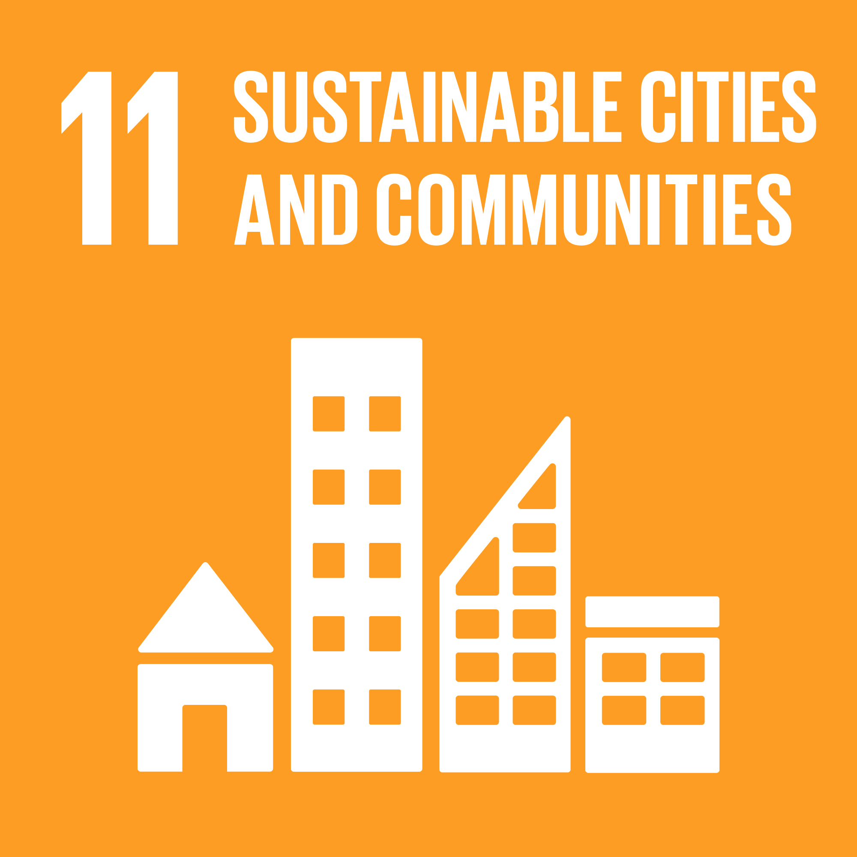
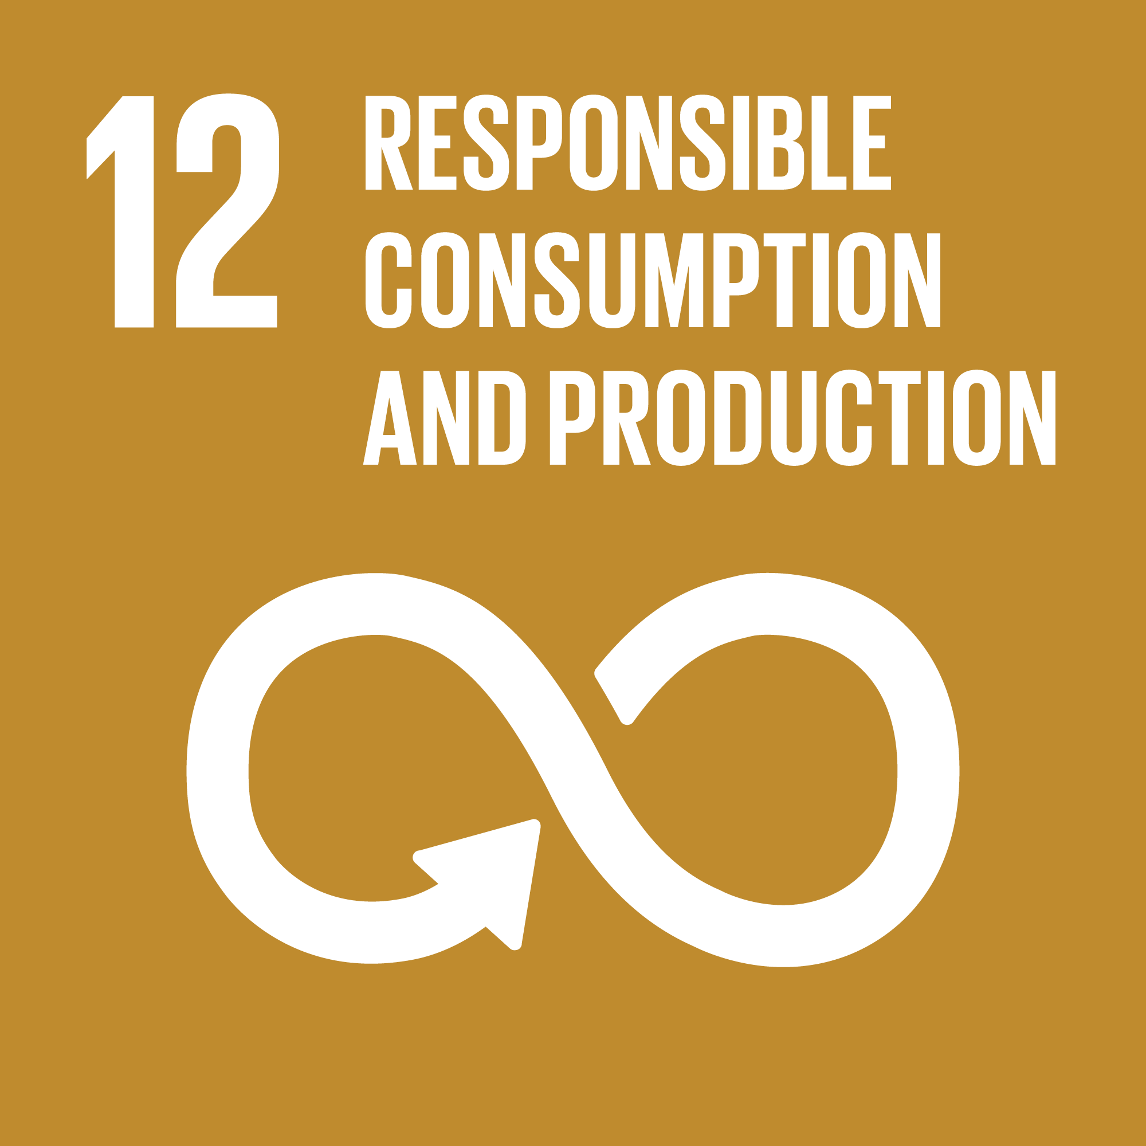
Sustainable Development Goals (SDGs) Impacted
Notes:
The project addresses ….

Slide 6
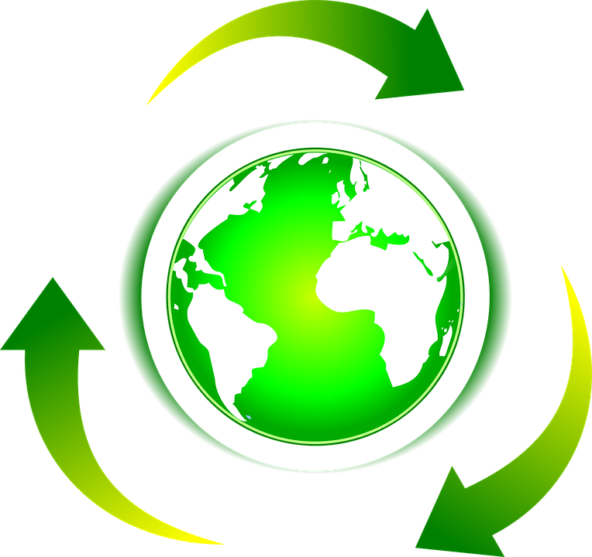
Our Goal
Amsterdam’s Citizen Involvement Campaign aims to incentivize and increase citizen engagement in recycling of textiles and textile products in Amsterdam, to:
Redirect textile waste into the Amsterdam second hand market
Decrease primary textiles consumption
Enable discarding less, discarding correctly
Although it is being developed to eventually be integrated into the REFLOW application, it also can be deployed as a stand-along application.
Notes:
Our specific goal then is to (read bullets). Although developed to eventually be integrated as part of Reflow, the EveryCycle application will also work as a stand-alone application.

Slide 7
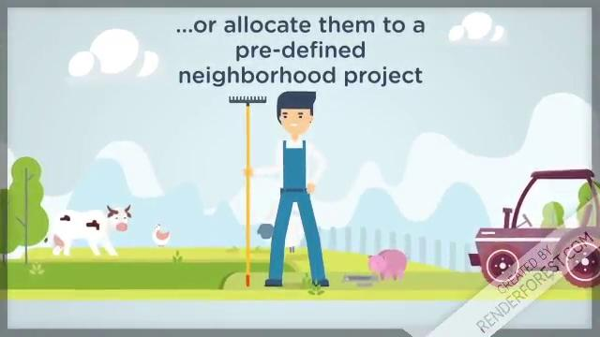
A little story…..
The Amsterdam pilot team has chosen one user story to focus on, involving value accreditation of citizen textile donations.
Notes:
(read and play)

Slide 8
Other possibilities for example...
Another user story that the pilot team in Amsterdam would like to implement is to facilitate sharing of equipment among many organizations in the textile circular economy, by exposing when various pieces of equipment are available for use by others. Or to facilitate different organizations joining to invest in shared equipment that can be scheduled by all, with opportunity to repay the investments over time using income from use of the equipment.
This user story also builds on the REFLOW project, and would make use of the value calculation configurations that were created for the citizen donation application.
Notes:
There are many possibilities for other user stories. One example that was discussed is to facilitate sharing of existing expensive and not fully utilized textile processing equipment among many organizations, or to facilitate organizations coming together to invest in shared equipment with opportunity to repay the investments over time using income from use of the equipment. The reason I bring this in is to note that this user story also builds on Reflow and makes use of a component developed for the EveryCycle app.

Slide 9
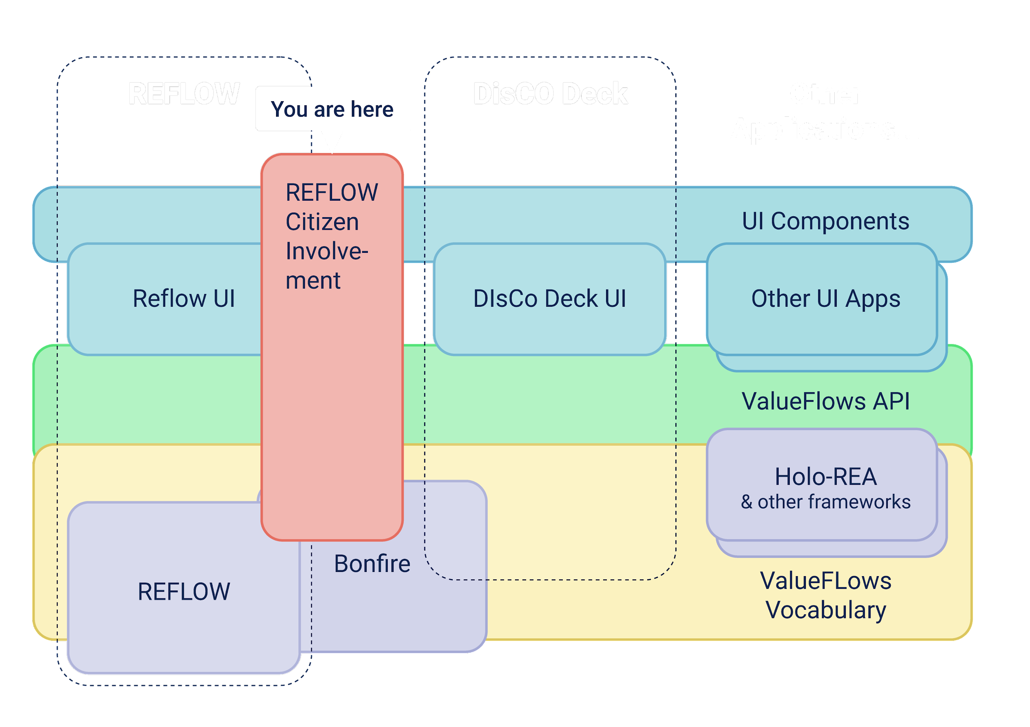
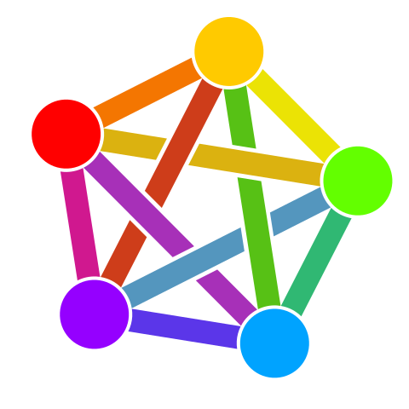
Software Ecosystem
This project enhances the REFLOW application.
This project uses an existing open source software ecosystem and contributes a new component back to the ecosystem, helping it grow so that others can benefit also.
It also allows people to participate in a federated social network that now has more than 4 million users.
The Federation
By Eukombos - Own work, CC0, https://commons.wikimedia.org/w/index.php?curid=70845534
Notes:
Which brings me to a discussion of the open source software ecosystem we are both making use of and adding to. There’s some complexity here, but basically there are different distributed backends being created, including the federated economic/social backend for Reflow, and also various UI components, that all use the Valueflows standard as the glue for assembling the pieces needed for specific use cases. EveryCycle supports a very targeted user experience, but makes use of the Reflow backend and contributes a new component to it. Besides other Amsterdam user stories, I know that DisCO (who initially received this grant) can make use of it.

Slide 10
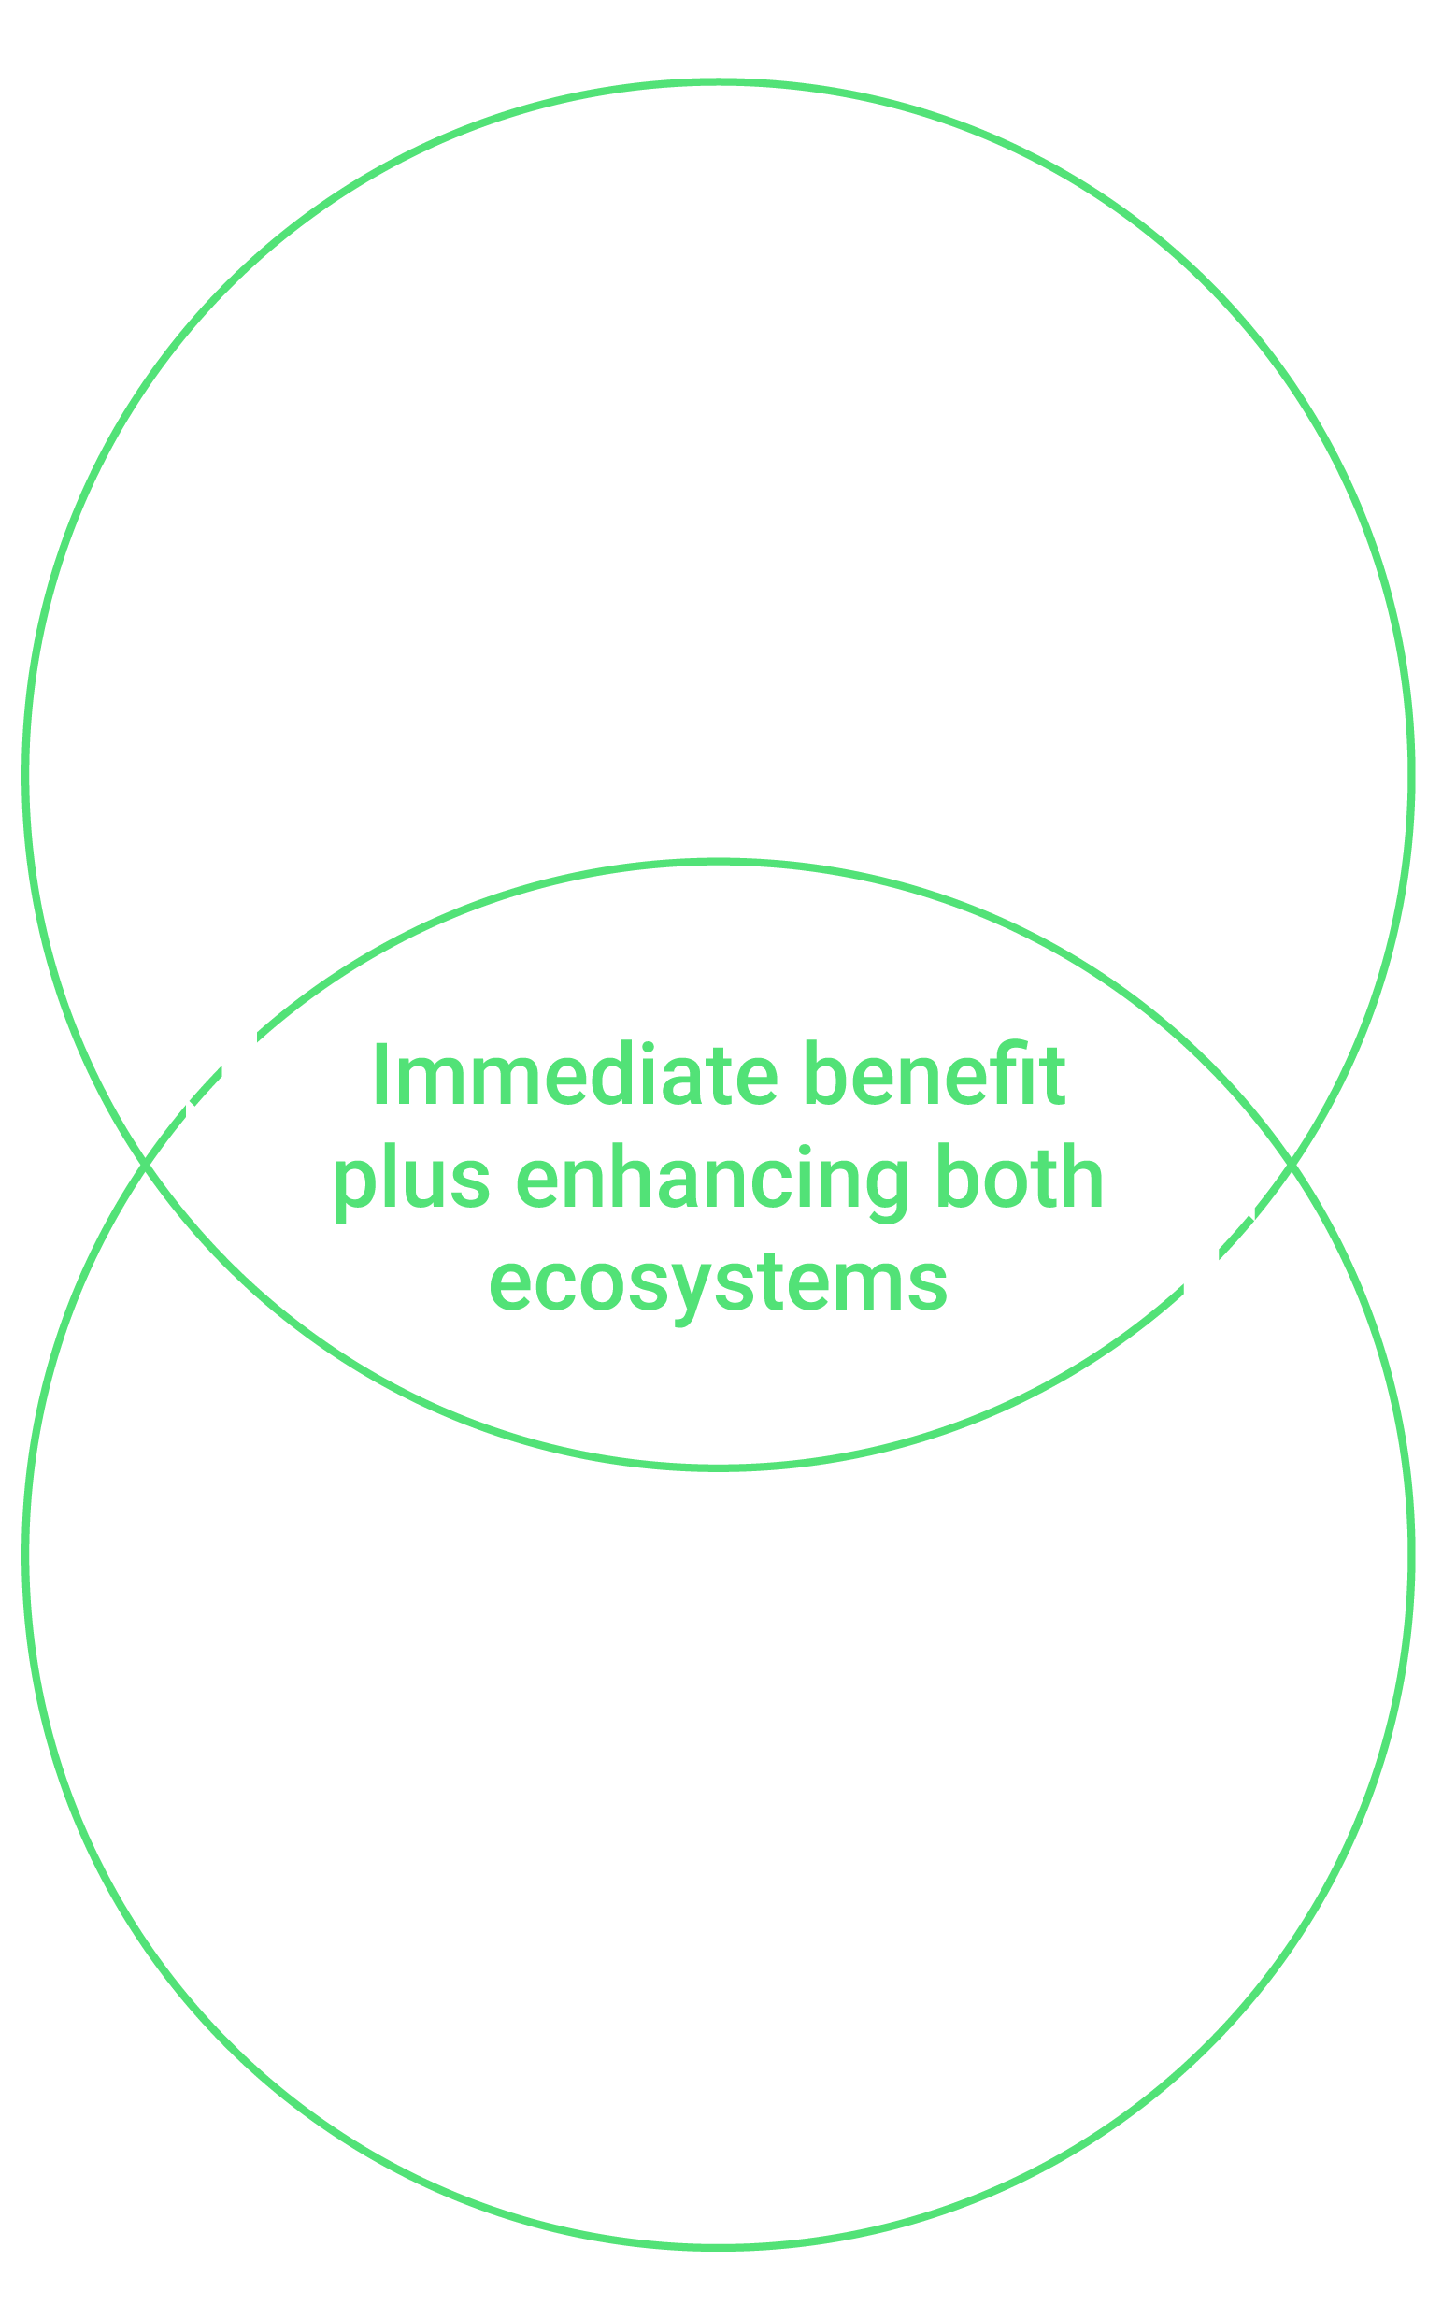
Benefits of a software ecosystem
There is a lot of code written already that we can use, lots of lessons learned, and access to people for consultation.
When it became clear that the original proposal did not fit well with the user needs, the project was able to pivot to something that did, by shifting which parts of the ecosystem are involved.
Notes:
A simpler way to tell the story: Amsterdam is building a more circular economy. Valueflows is building software for economic networks. And those two ecosystems met in the Reflow and EveryCycle projects. This gives us: a lot of code and expertise; and when it became clear that the original proposal from DisCo did not fit well, the project was able to pivot to something that does fit well, within the same software and people ecosystem.

Slide 11
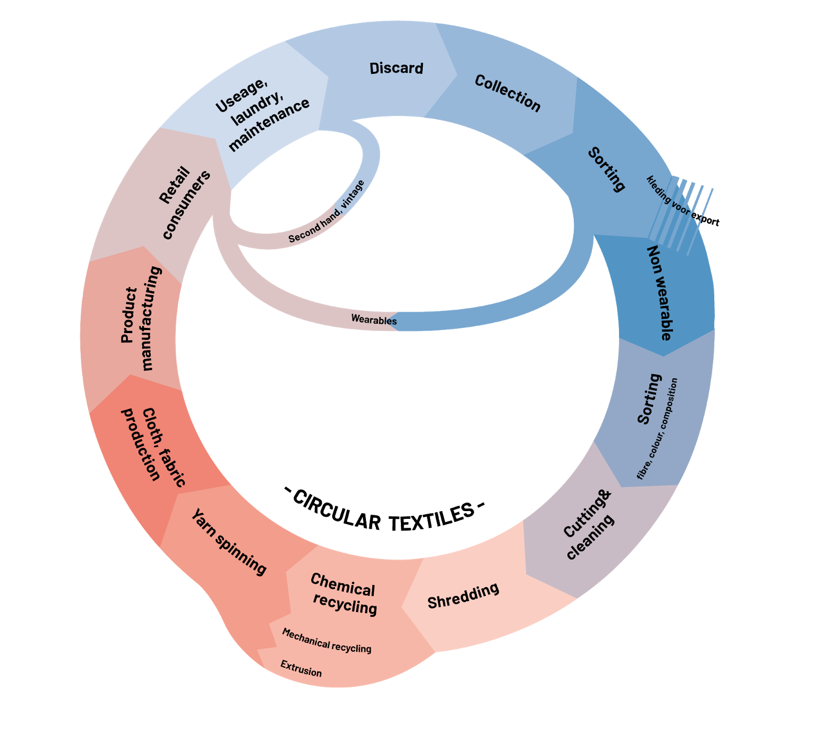
Valueflows
Here again is the Amsterdam goal for a circular textile economy. It documents a set of high level resource flows through the different kinds of processes used in the textile industry.
The Valueflows model also reflects resource flows, at any level from operational to analytical.
Every resource flow on that diagram can be represented in software by a Valueflows message. And all of the flows will be recorded on a distributed ledger so citizens can track and trace every movement of the textiles in Amsterdam, backwards and forwards, where they came from, and where they went.
If I donated some textiles, what happened to them? If I purchased some clothing, where did it come from? The flows know.
Notes:
A little more explanation of Valueflows itself. We see again the proposed Amsterdam circular textile economy. (read)

Slide 12
Reflow / EveryCycle DLT
Many distributed ledgers only account for crypto-currencies like Bitcoin.
Using Valueflows, the distributed ledger can account for all resources circulating in the circular economy.
In the Amsterdam circular economy pilot project, that’s textiles and related used goods like shoes.
In Vejle, Denmark, that’s plastics. In Milan, that’s food.
In other pilots https://reflowproject.eu/pilots/ , other resources.
They can all be tracked in a Reflow/EveryCycle DLT.
Notes:
And a bit more explanation of the federated DLT. (read)

Slide 13
Commitment to open source
We are enthusiastically committed to open source. Our standard practice is that all of our code is published as it is written and tested, from the beginning of every project.
It is part of our mission to help build the software commons, especially the software infrastructure needed to support distributed networked groups working on the economic changes that will be required for planetary survival.
Working in the open source software community is very productive.
Developers willingly help each other across projects
There is a lot of software available to use, fork, and learn from
Notes:
And to emphasize our commitment to open source. This kind of software ecosystem couldn’t function without being open source. We are all enthusiastically committed. Building this kind of commons supports projects like circular economies in Amsterdam, and can support many many others. And it is very productive.

Slide 14
The proof of concept software
There will be 4 separate applications created when this story is complete:
Configuration, done by administrators of the program (mostly complete)
Informational map open on the web with information for citizens: drop-off sites for used textiles, and local businesses who accept tokens (partially complete)
Donations, done by workers at drop-off sites
  Recording of donations and calculation of tokens (complete as a proof of concept)
  Transfer of the tokens to the citizens, either electronically or physically (not part of the proof of concept)
Recording of acceptance of tokens in payment for goods and services, used by local businesses (not part of the proof of concept)
Notes:
So, on to the EveryCycle proof of concept. (read)

Slide 15
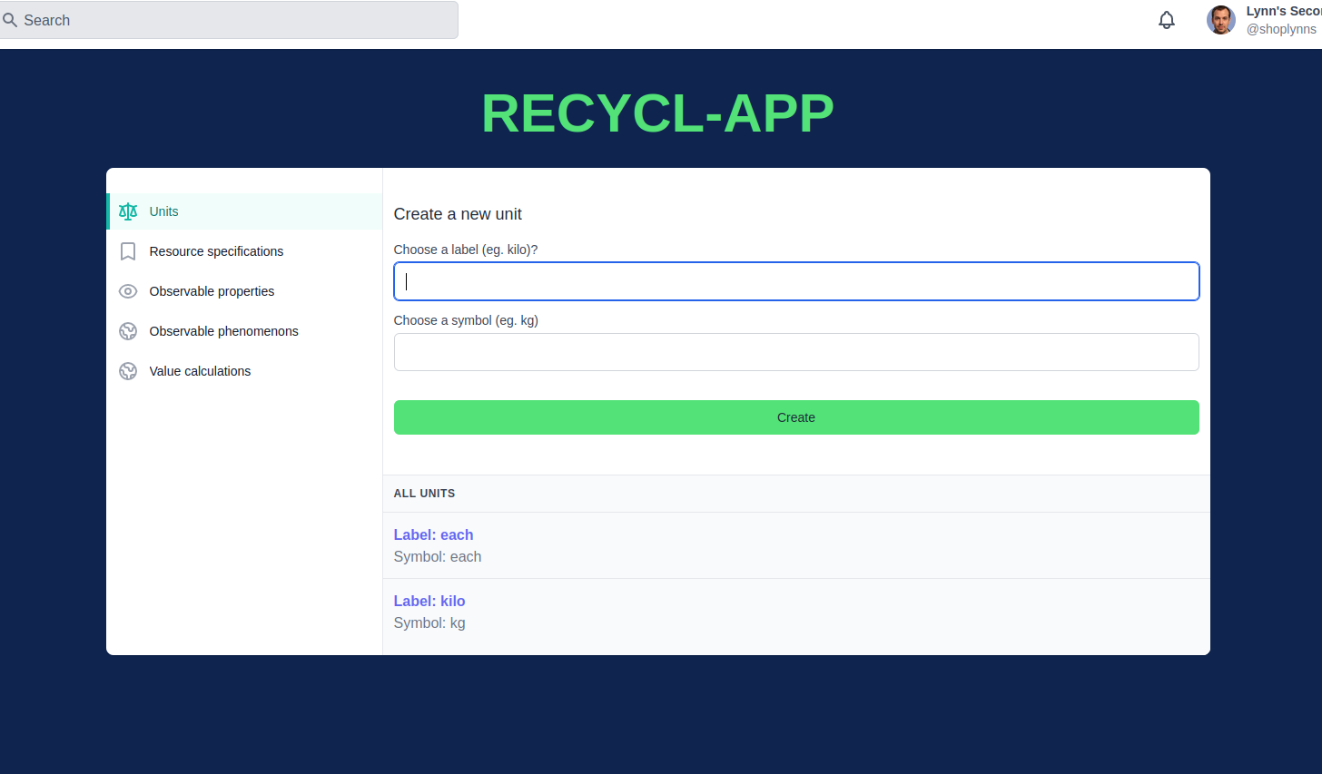

Configuration application
Units of measure can be configured in the app. Eventually, the units of measure from Reflow could be used, and it is best to coordinate units as much as possible for maximum interoperability with the rest of the circular economy.
Notes:
I’m going to show you the configuration of the application in slides rather than video, it’s a bit lengthy. These pages do work however.
I’m going to show you the configuration of the application in slides rather than video, it’s a bit lengthy. These pages do work however.

Slide 16
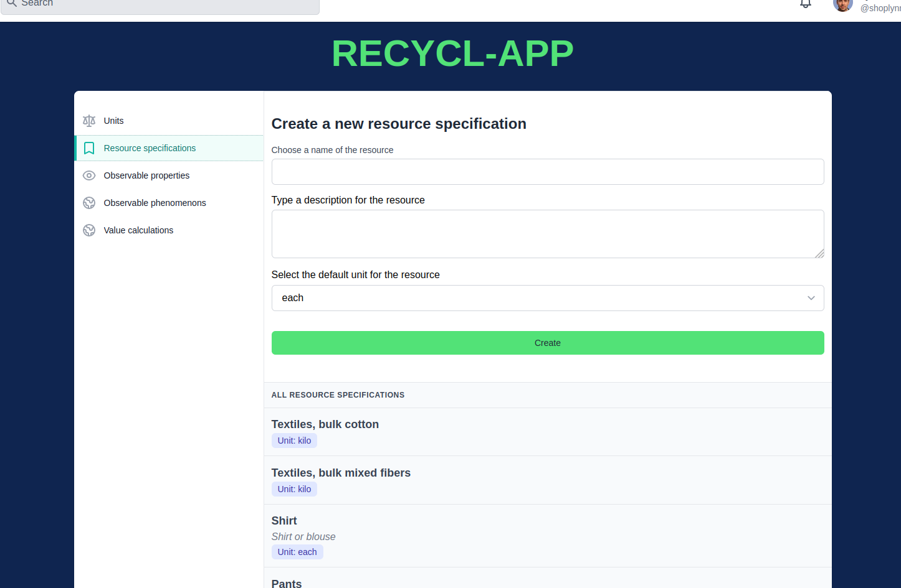
Configuration application
Resource specifications are used to define all the types of resources needed by the application. This includes types of textiles that could be donated, defined as specifically as desired. One way to think about the specificity is that if different types of resources require different formulas to calculate tokens, they should be broken out to support that. It also includes whatever tokens will be used.
Notes:
I’m going to show you the configuration of the application in slides rather than video, it’s a bit lengthy. These pages do work however.

Slide 17
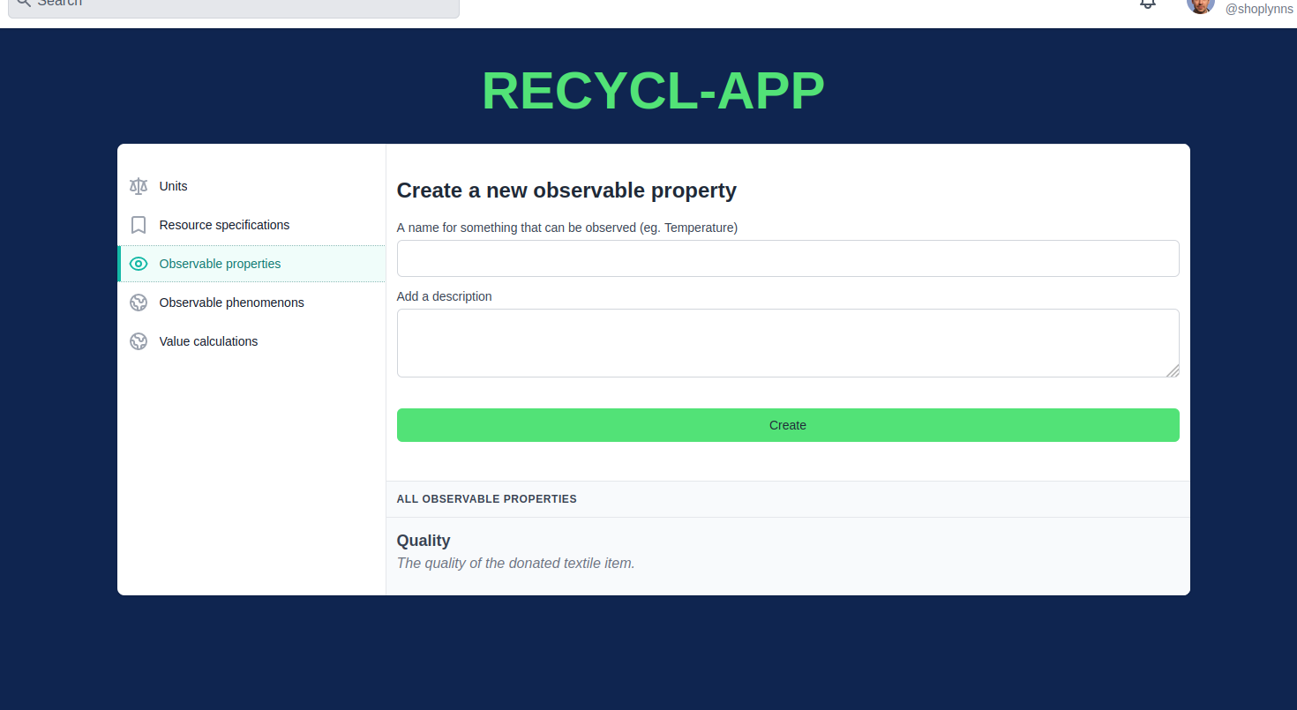
Configuration application
This setting gives the administrators a way to define the quality measure to be used when donations are received....
Notes:
I’m going to show you the configuration of the application in slides rather than video, it’s a bit lengthy. These pages do work however.

Slide 18
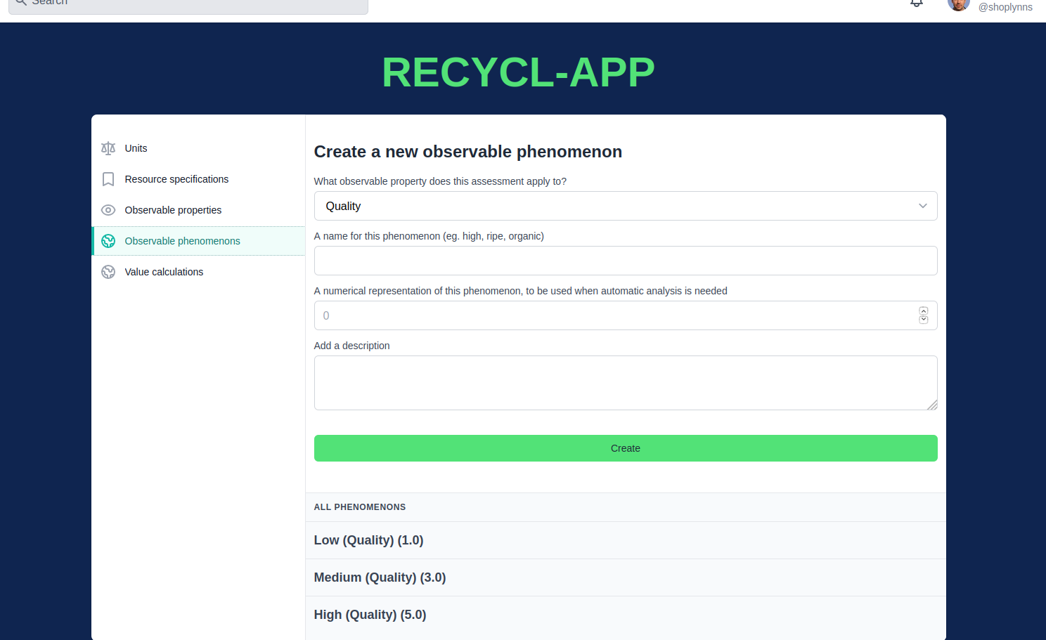
Configuration application
… and the choices for that quality measure. Each choice is given a numeric factor that can be used in the formula for creating tokens. This gives the capability to reward more tokens for higher quality donations.s.
Notes:
I’m going to show you the configuration of the application in slides rather than video, it’s a bit lengthy. These pages do work however.

Slide 19
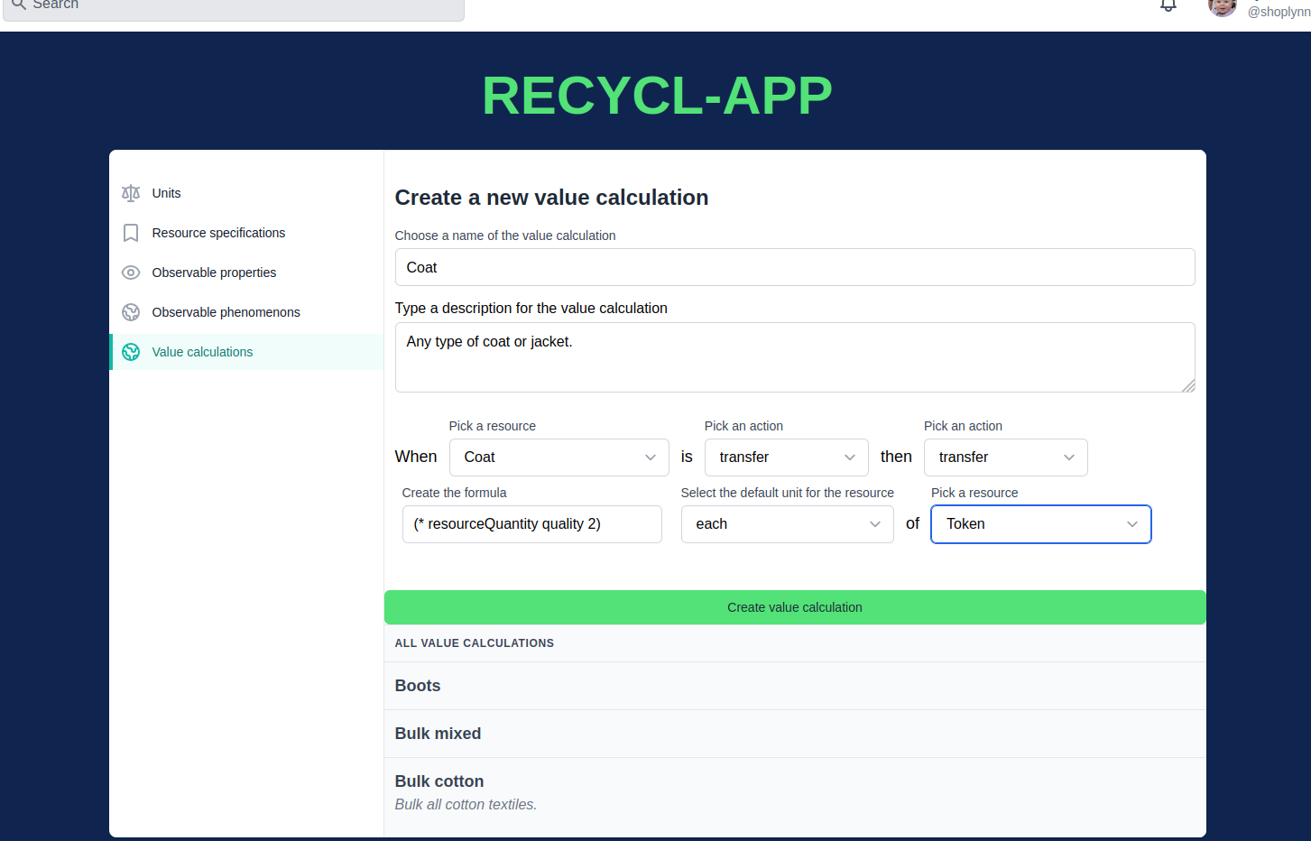
Configuration application
Finally, the program administrators can define as many ways to calculate tokens as they need, for different types of donations, both bulk and specific kinds of items. The formula can take into account both quantity and quality of a donation.
This screen can also be used to configure other rewards besides tokens, if ever needed.
This set of configurations make it possible to use this app in any industry or setting.
Notes:
I’m going to show you the configuration of the application in slides rather than video, it’s a bit lengthy. These pages do work however.

Slide 20
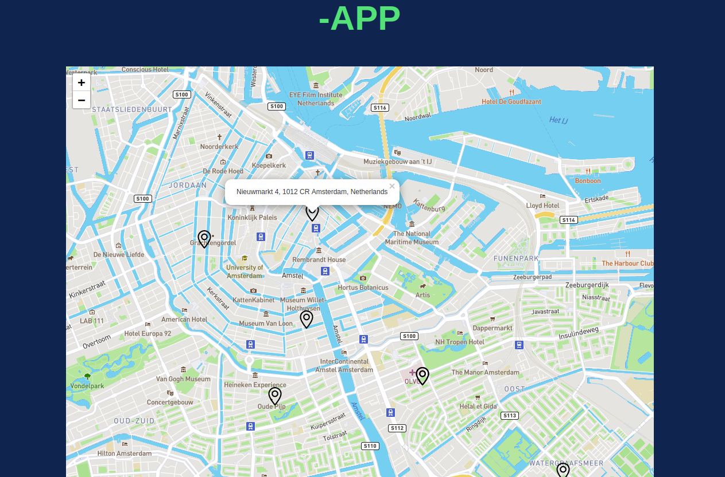
Informational map
The map of drop-off sites and local businesses accepting tokens would be openly available on the web.
The map works for drop-off sites. It could be enhanced to toggle between drop-off sites and local businesses. Or it could show both, with different visual representations.
Notes:
The second app.
I’m going to show you the configuration of the application in slides rather than video, it’s a bit lengthy. These pages do work however.

Slide 21

Donation receipt application
Here is a recorded demo of the donation application.
Notes:
The main app, which uses the configuration we saw a bit ago.
I’m going to show you the configuration of the application in slides rather than video, it’s a bit lengthy. These pages do work however.

Slide 22
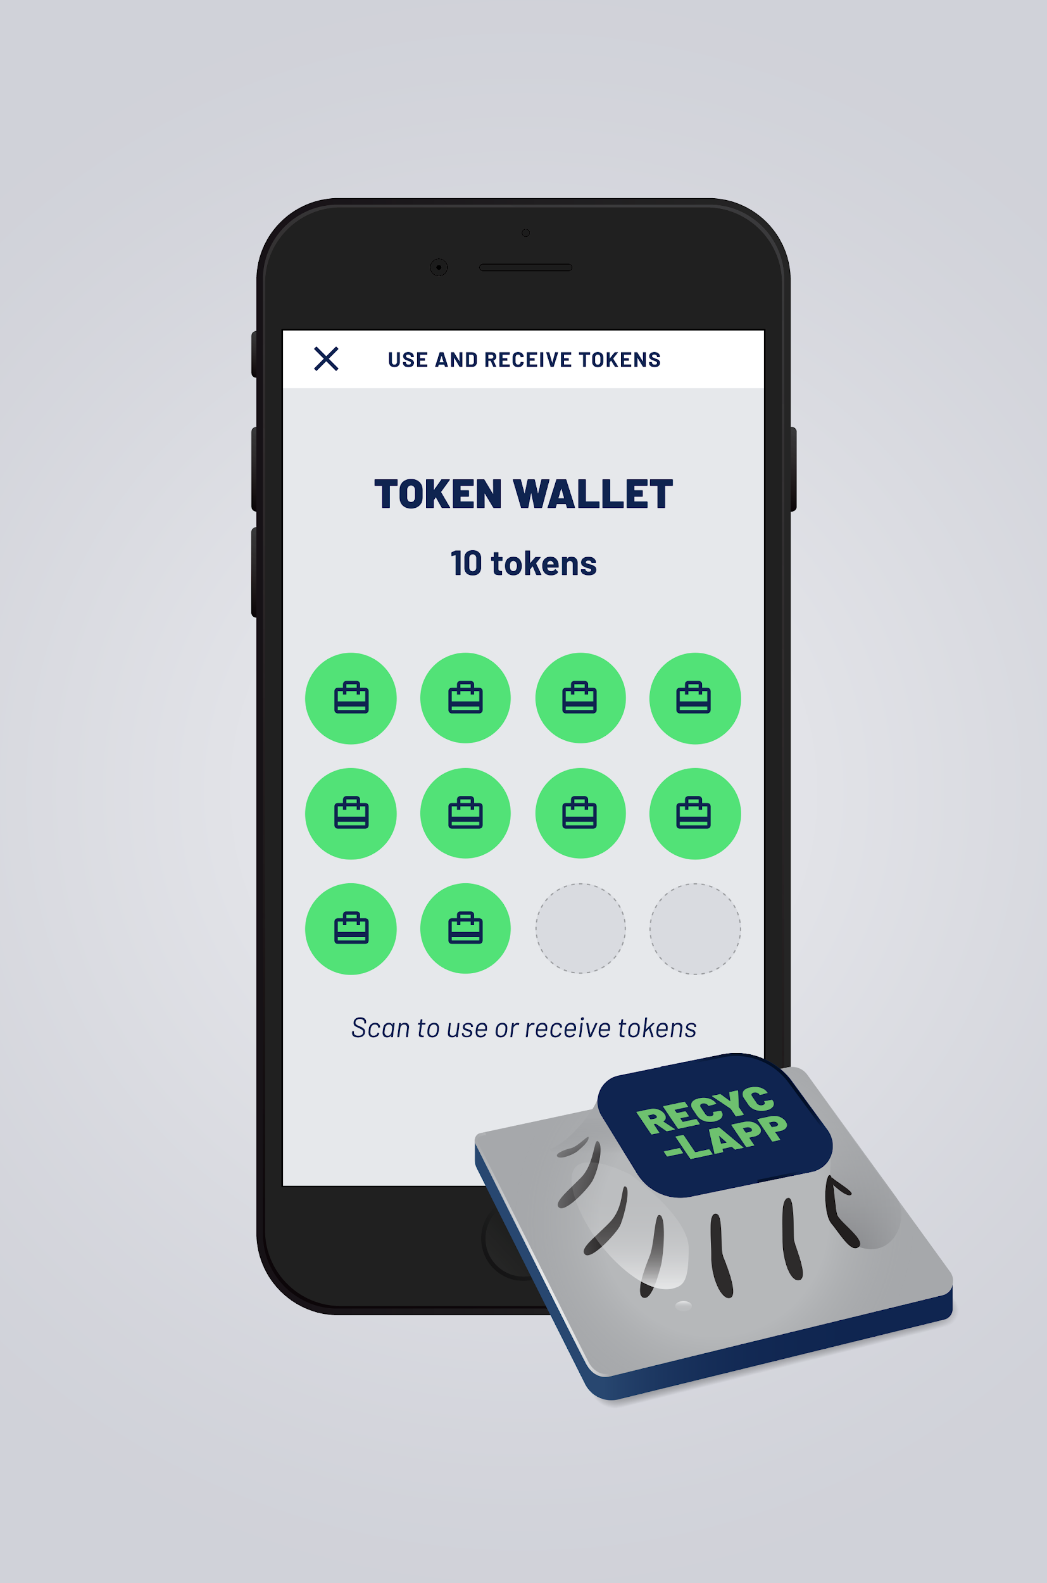
Donation receipt application
A technical possibility that underwent preliminary investigation is to use existing available software and a special device for electronically transferring tokens to the citizen’s phone. This enables the citizen to remain anonymous when they spend their tokens, which would exist only in a wallet on the phone.
However, the Amsterdam pilot user group was not ready to make a decision on what token(s) to use. There are some already existing local tokens that are a possibility, in addition to various technical options.
Notes:
I’m going to show you the configuration of the application in slides rather than video, it’s a bit lengthy. These pages do work however.

Slide 23
Tokens as payment in local businesses
Once the citizen has tokens, they could use them in local businesses who accept them. This part of the story was not implemented, nor has it been envisioned in any detail. It will depend on the token(s) chosen.
Notes:
I’m going to show you the configuration of the application in slides rather than video, it’s a bit lengthy. These pages do work however.

Slide 24
Our team thanks you!
ValueFlows: Lynn, Maro (user requirements, specs, project coordination, documentation)
Bonfire: Antonis lead with help from the rest of the Bonfire team (development)
DisCO: Stacco (grant contact)
Working in partnership with Ista and Cecilia of the Amsterdam Reflow pilot team and our extremely helpful sponsor Metabolic.

